Slide 1

Data Analytics Job Opportunities
November 11, 2021

Slide 2

Data Cleaning
Selected dataset from Kaggle.com
Removed unnecessary columns
Split the “Salary range” column and calculated the Average salaries based on the ranges
Used. Lambas, pcut and bins to help
Removed incomplete/null values
Still contained over 1800 data points
Used Excel & Jupyter Notebook

Slide 3
Machine Learning

Slide 4
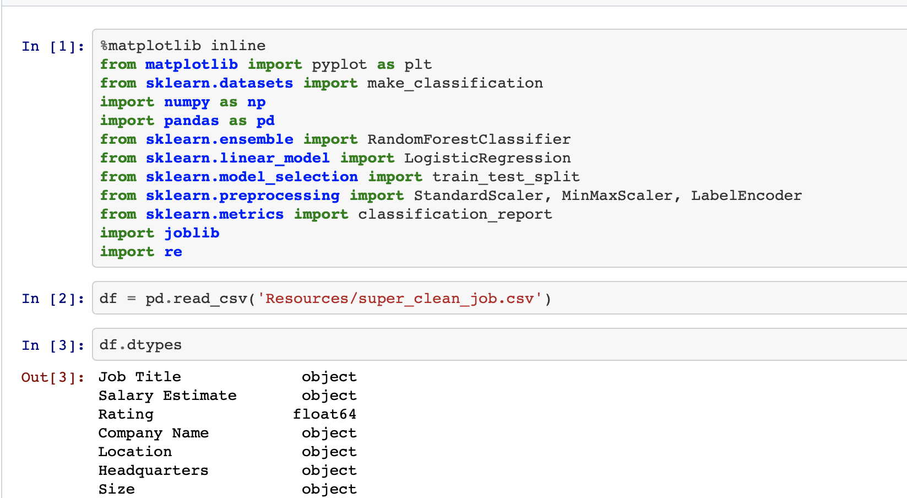
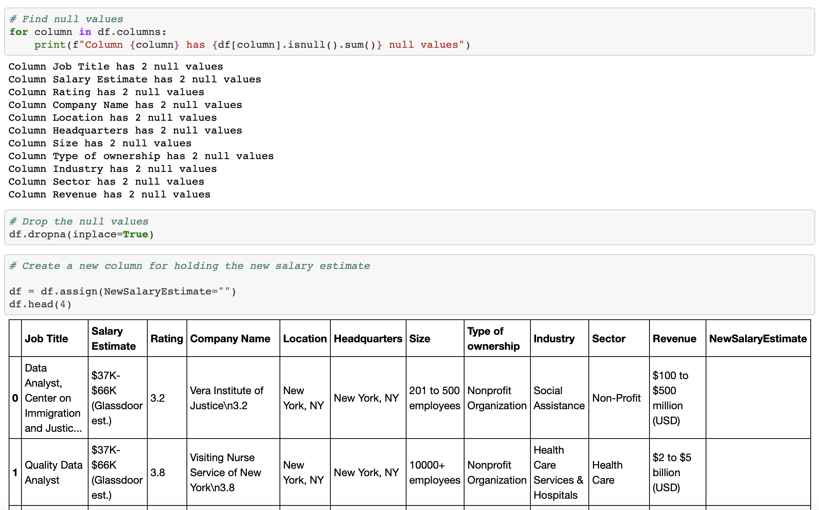
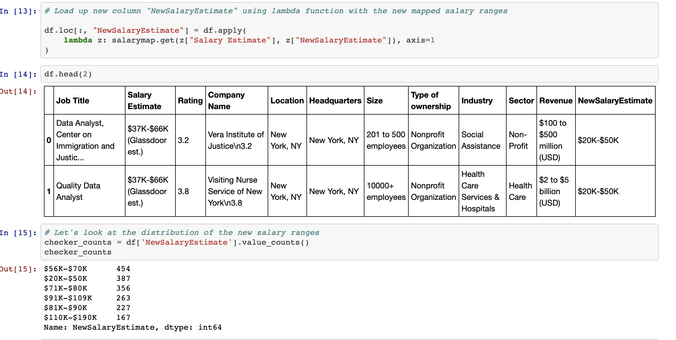
Data cleaning samples
Key steps:
Identify dependencies
Clean file using functions such as drop, dropna
Remove Null values
Created a python dictionary,

Slide 5
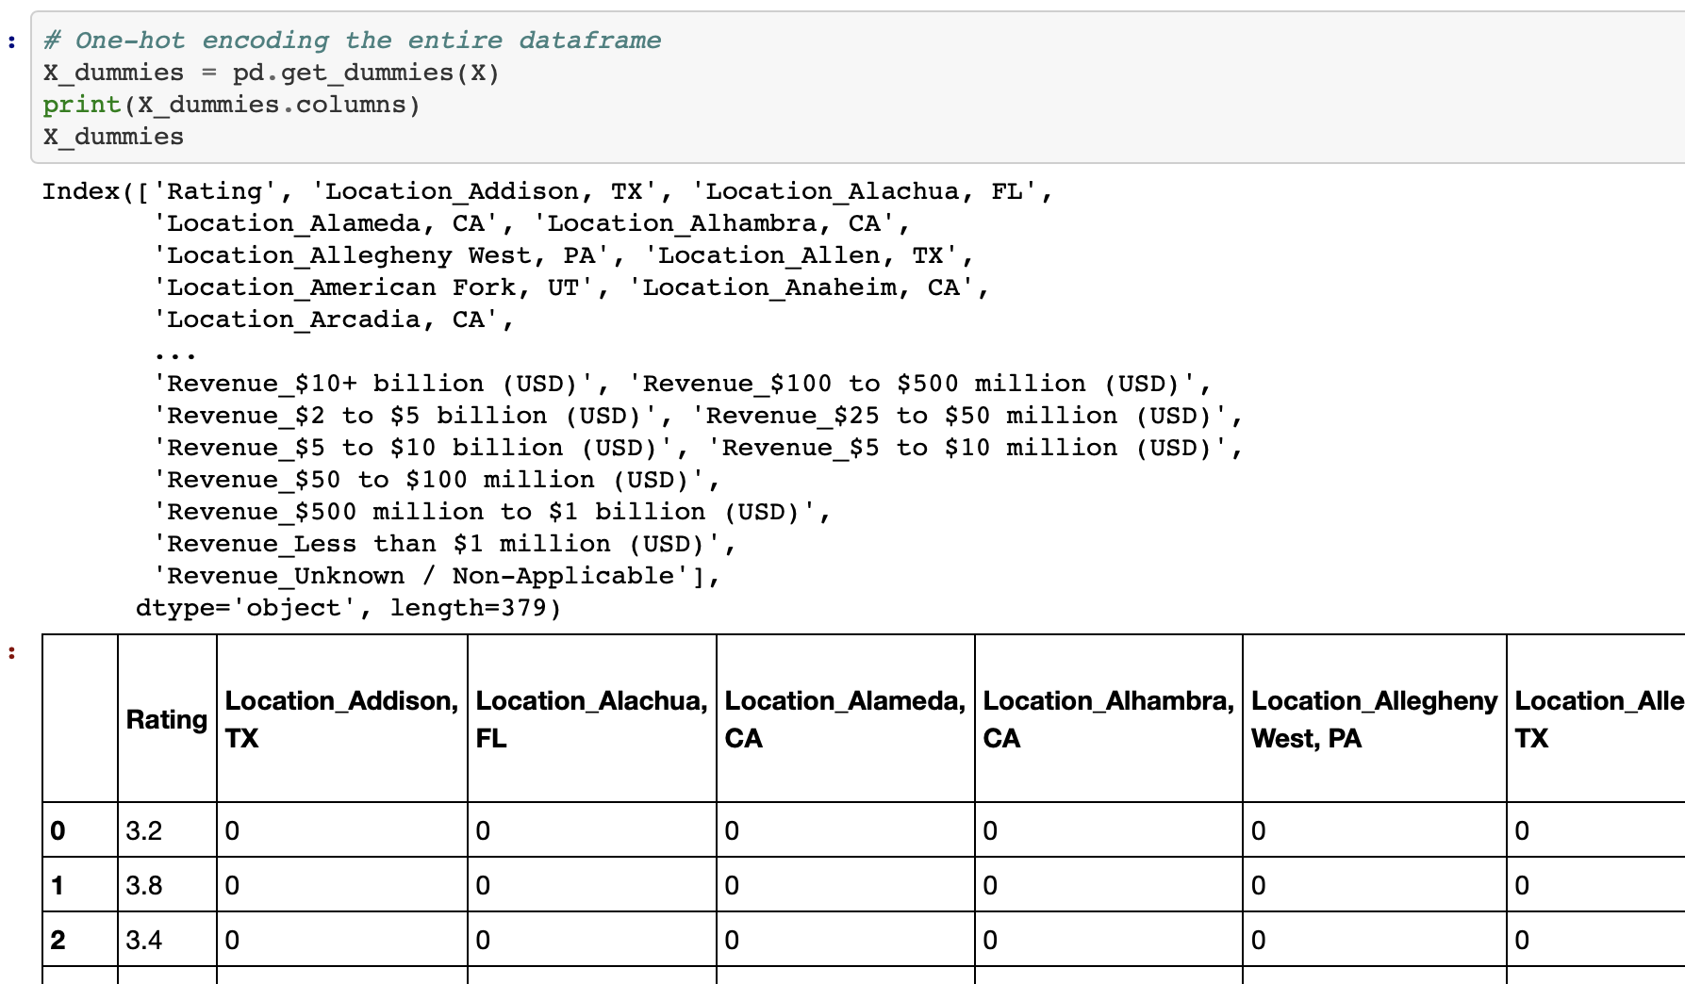
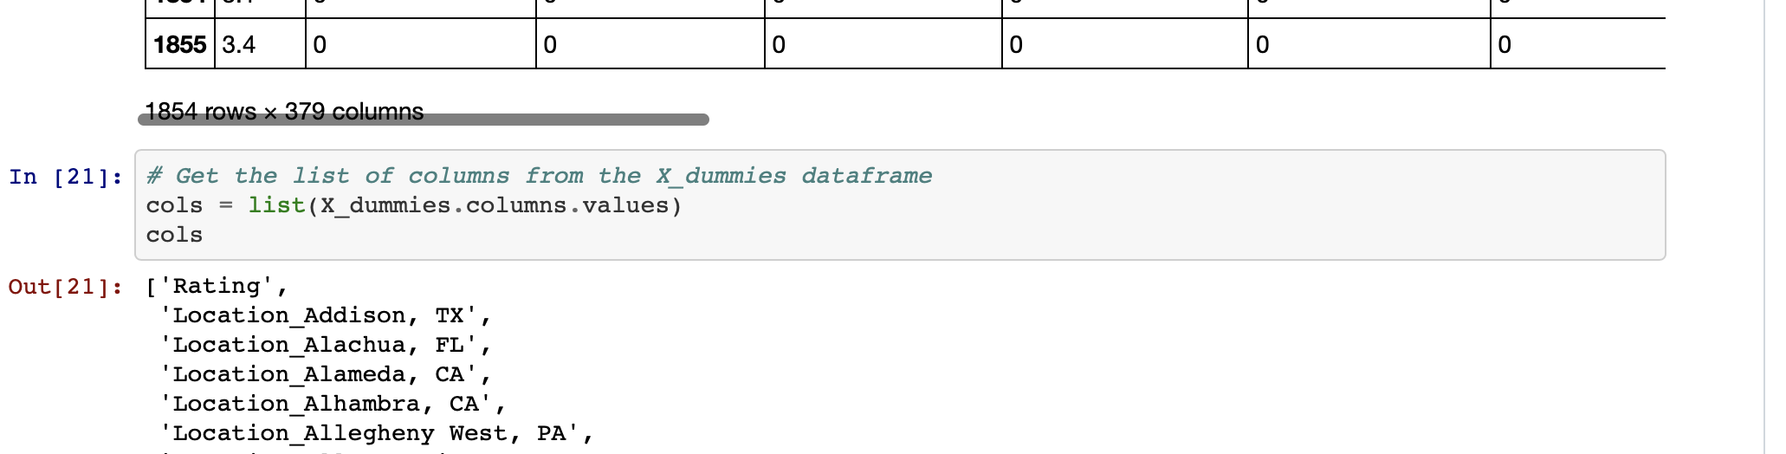
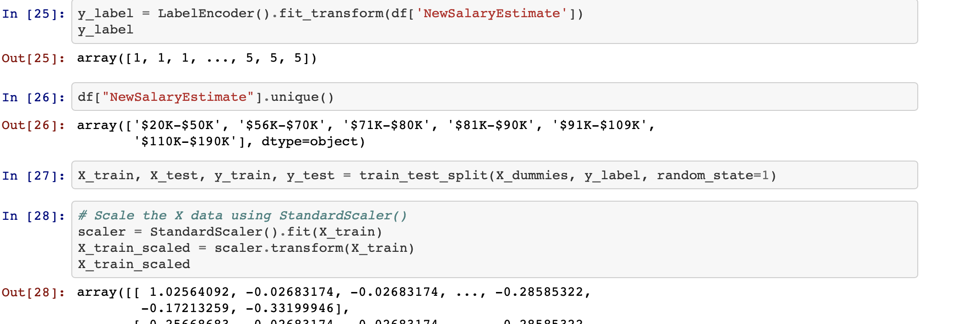
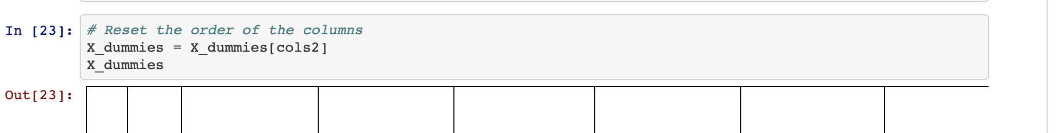
Machine Learning summary
Key steps:
Reviewed multiple ML strategies Random Forest Classifier and Random ForestRegressor
Aligned on using Random Forest Classifier
Label, Scale, Fit, Predict,
Adequate accuracy rate for proposal

